Slide 1
Advanced language features
Macros and tricks for your instrument…

Slide 2

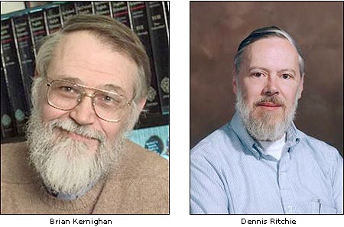

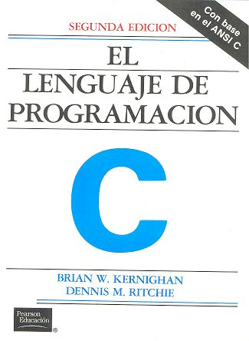
DECLARE / INITIALIZE
Use the DECLARE section define user variables and functions.
DECLARE %{
double some_global_var;
%}
Use USERVARS for particle-dependent flags
USERVARS %{
double myvar;
%}
Use INITIALIZE for initialization of user variables and calculations.
INITIALIZE %{
myvar = sqrt(PI*input_var)*rand01();
%}
- Both use normal c-syntax.
BEWARE: (example) What you do in the c-style areas is c-standard, e.g. trigonometric functions from math.h use radians! - McStas placement specifiers work in degrees, etc...
K & R. / GNU

Slide 3
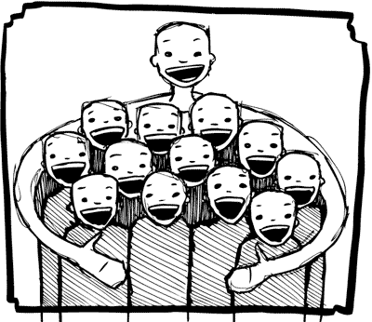
%include
Instrumentfiles can include external c-code or other instrumentfiles... See the examples:
ILL_H15_IN6.instr:%include "monitor_nd-lib"
ILL_H16_IN5.instr:%include "ILL_H16.instr"
ILL_H25_IN22.instr:%include "ILL_H25.instr"
ILL_H25_IN22.instr:%include "templateTAS.instr"
Used in the DECLARE section

Slide 4
Syntax in one, complex view...
{SPLIT} COMPONENT name = comp(parameters) {WHEN condition}
AT (...) [RELATIVE [reference|PREVIOUS] | ABSOLUTE]
{ROTATED {RELATIVE [reference|PREVIOUS] | ABSOLUTE} }
{GROUP group_name}
{EXTEND C_code}
{JUMP [reference|PREVIOUS|MYSELF|NEXT] [ITERATE number_of_times | WHEN condition] }

Slide 5
SPLIT
Increase statistics beyond this point in the instrumentfile
SPLIT n MyArm = Arm()
AT somewhere
will “formulate an if-statement”:
for j=1:n
comp1
comp2
comp3
...
end (of instrument)
ONLY meaningful in case of Monte Carlo choices after SPLIT point...

Slide 6
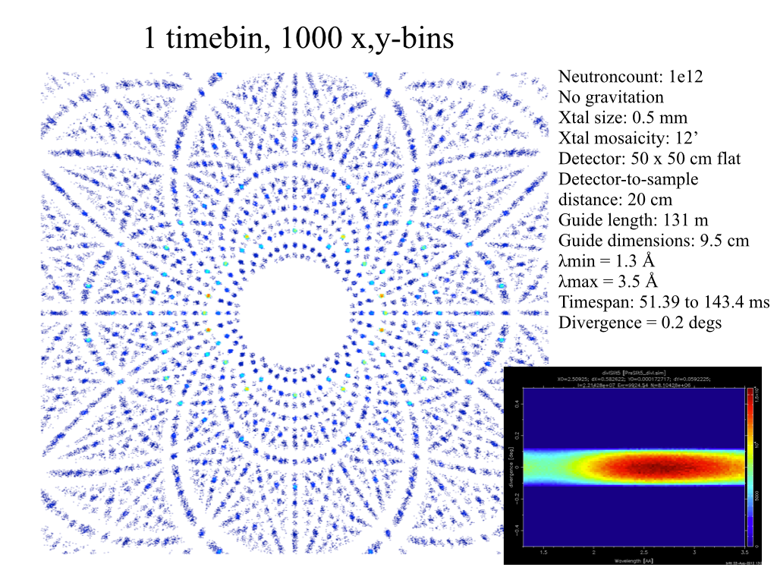
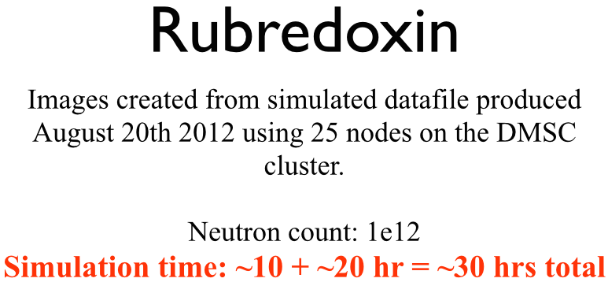
Problem: McStas Single_crystal.comp “slow” for large unit cell diffraction studies
slight sidetrack….
Example: Rubredoxin
Reflection list ~ 124 K reflections (still “small” in the PX world!!)

Slide 7
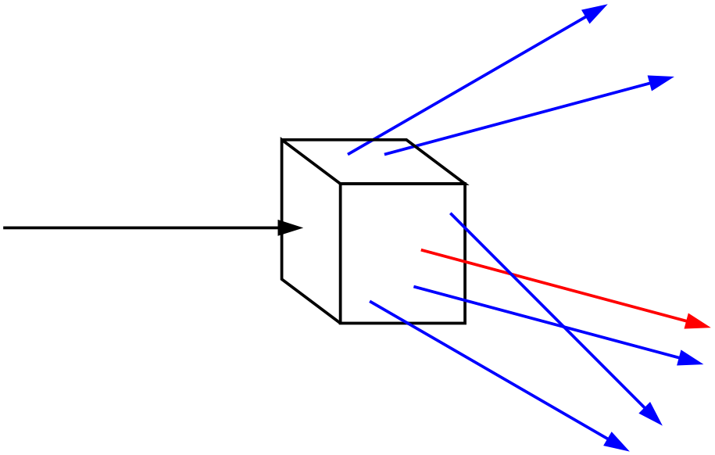
Algorithm improvement: Use incoming neutrons more efficiently - scatter each one on all possible reflections
slight sidetrack….
Red: Original algorithm, one incoming neutron used only once
Blue: Improved algorithm, each incoming neutron scattered (via SPLIT keyword) all possible times
Component makes estimate on average number of “active” diffraction spots - in the case Rubredoxin this is around 50!
!!! For now, does not work in our GPU implementation !!!

Slide 8

GROUP - components working in parallel
COMPONENT Mono1 = Monochromator_curved(...)
AT (0,0,-LMM) RELATIVE Cradle ROTATED (0,A1/2,0) RELATIVE Cradle
GROUP IN6Monoks
COMPONENT Mono2 = Monochromator_curved(...)
AT (0,0,0) RELATIVE Cradle ROTATED (0,A2/2,0) RELATIVE Cradle
GROUP IN6Monoks
- One comp after the other is “tried” in sequential order until the neutron was SCATTERED.

Slide 9
EXTEND
Enrich component behaviour using EXTEND:
COMPONENT Mono1 = Monochromator_curved(...)
AT (0,0, -LMM) RELATIVE Cradle ROTATED (0,A1/2,0) RELATIVE Cradle
GROUP IN6Monoks
EXTEND
%{
if (SCATTERED) { myvar = 1; }
%}
...
COMPONENT Mono2 = Monochromator_curved(...)
AT (0,0, 0) RELATIVE Cradle ROTATED (0,A2/2,0) RELATIVE Cradle
GROUP IN6Monoks
%{
if (SCATTERED) { myvar = 2 ;}
%}
K & R. / GNU

Slide 10

WHEN
Syntax:
COMPONENT Mine = Yours(blah, blah)
WHEN (c-expression) AT (....)
Is very powerful when combined with EXTEND and user variables, or as a method to let input parameters select if certain components are active.
Example: Use EXTEND to flag if neutron was scattered on one monochromator blade or another. Then later use WHEN to only show contribution from blade N at sample position?
COMPONENT Mon = PSD_monitor(...)
WHEN (myvar==1) AT (0,0,0) RELATIVE Sample
K & R. / GNU

Slide 11
JUMP
A goto. Be careful. Can be used in two situations:
JUMP to myself
JUMP to an Arm
No coordinate transformations are applied... (Meaning that if the Arms you JUMP between do not coincide you will “move” / “reorient” the neutrons...)
Syntaxes:
COMPONENT a=b(...)
WHEN (expr) AT (...) JUMP somewhere
COMPONENT a=b(...)
WHEN (expr) AT (...) JUMP myself
Van Halen...

Slide 12
JUMP
A goto. Be careful. Can be used in two situations:
JUMP to myself
JUMP to an Arm
No coordinate transformations are applied... (Meaning that if the Arms you JUMP between do not coincide you will “move” / “reorient” the neutrons...)
Syntaxes:
COMPONENT a=b(...)
WHEN (expr) AT (...) JUMP somewhere
COMPONENT a=b(...)
WHEN (expr) AT (...) JUMP myself
BEWARE - This IS a GOTO!
Van Halen...

Slide 13
JUMP
A goto. Be careful. Can be used in two situations:
JUMP to myself
JUMP to an Arm
No coordinate transformations are applied... (Meaning that if the Arms you JUMP between do not coincide you will “move” / “reorient” the neutrons...)
Syntaxes:
COMPONENT a=b(...)
WHEN (expr) AT (...) JUMP somewhere
COMPONENT a=b(...)
WHEN (expr) AT (...) JUMP somewhere
BEWARE - This IS a GOTO!
Van Halen...

Slide 14
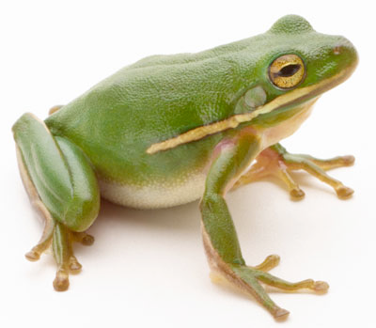
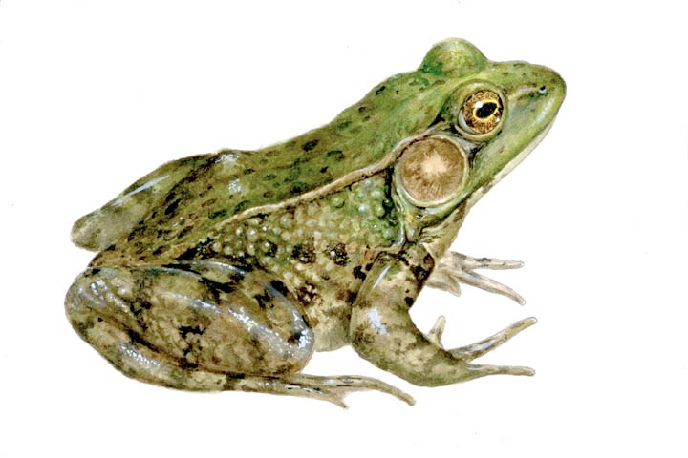
COPY- inside instruments
In instruments: (see ILL_H25.instr)
COMPONENT H25_1 = Guide_gravity(
w1=0.03, h1=0.2, w2=0.03, h2=0.2, l=L_H25_1,
R0=gR0, Qc=gQc, alpha=gAlpha, m=m, W=gW)
AT (0,0,Al_Thickness+gGap) RELATIVE PREVIOUS
ROTATED (0,Rh_H25_1,0) RELATIVE PREVIOUS
COMPONENT COPY(H25_1) = COPY(H25_1)
AT (0,0,L_H25_1+gGap) RELATIVE PREVIOUS
ROTATED (0,Rh_H25_1,0) RELATIVE PREVIOUS
COMPONENT COPY(H25_1) = COPY(H25_1)(W=2*gW)
AT (0,0,L_H25_1+gGap) RELATIVE PREVIOUS
ROTATED (0,Rh_H25_1,0) RELATIVE PREVIOUS

Slide 15
Example: Decompose multiple scattering from Single_crystal
USERVARS %{
double multiple_scatt;
%}
…
COMPONENT Crystal = Single_crystal(… order=0 …)
AT (0,0,0) RELATIVE somewhere
EXTEND %{
multiple_scatt=SCATTERED;
%}
…
COMPONENT PSD_single=PSD_monitor(…)
WHEN (multiple_scatt==1) AT (0,0,0) RELATIVE somewhere_else
COMPONENT PSD_multiple=PSD_monitor(…)
WHEN (multiple_scatt > 1) AT (0,0,0) RELATIVE somewhere_else

